Slide 1
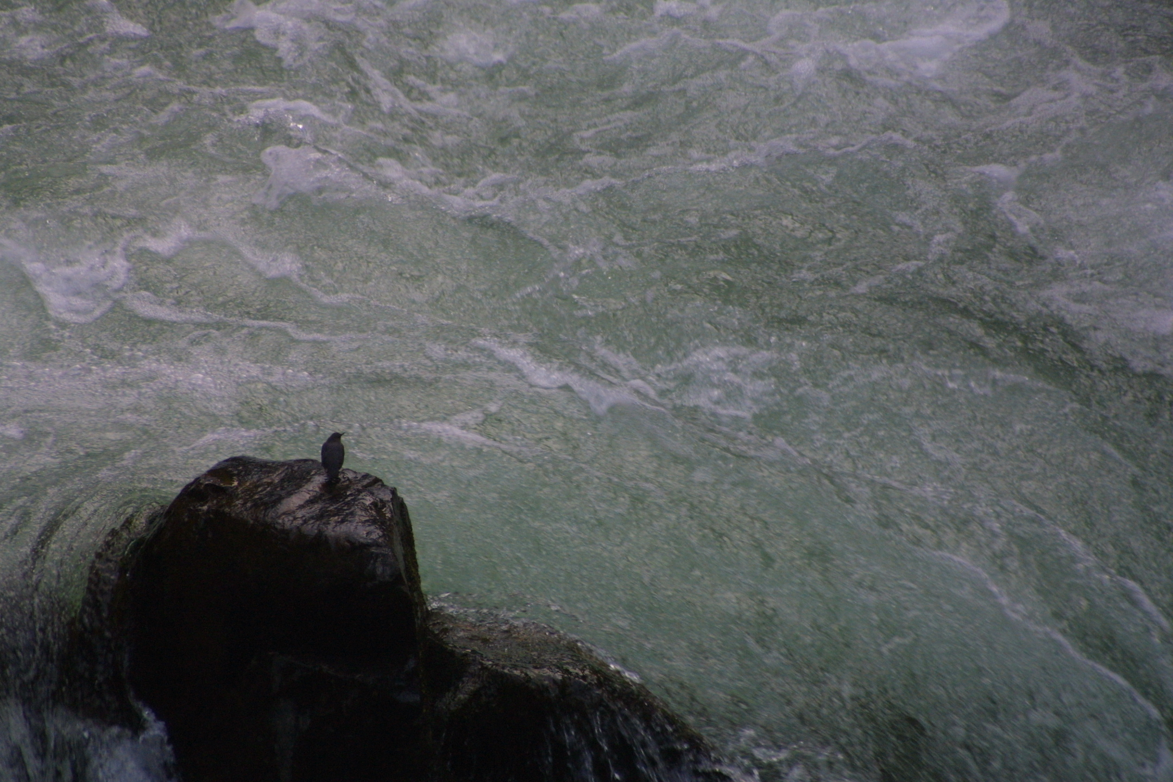
Tools and Strategies for Assessing and Managing Riverine Condition.
Flow 2015
April 28, 2015
Ian Chisholm
Stream Habitat Program
Division of Ecological and Water Resources
Minnesota Department of Natural Resources

Slide 2

General Workshop Outline
2
Context of Our Work
1
3
Goal
Systems
5
4
An Approach

Slide 3
General Workshop Outline
2
Context of Our Work
1
3
Goal
Systems
5
4
An Approach

Slide 4

The Goal is Sustaining Healthy Systems.
Balancing water use (surface and groundwater) for present day with healthy functioning streams, lakes, aquifers, and watershed systems (future use).
The first principle is that you must not fool yourself – and you are the easiest person to fool.
Richard Feynman

Slide 5
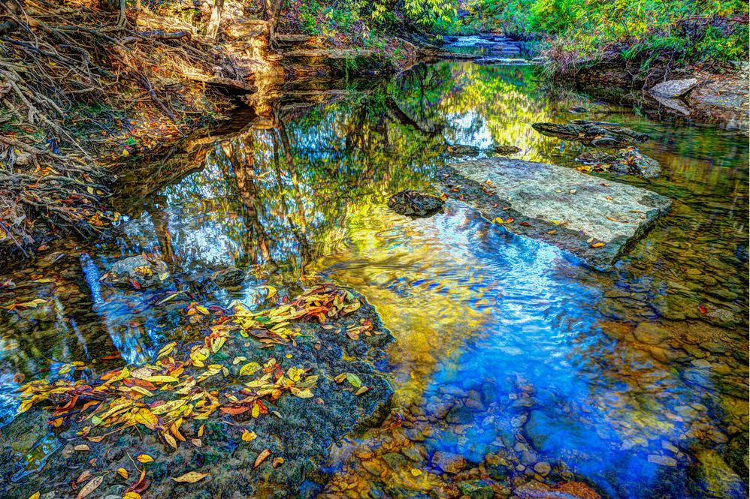
Definitions
Sustainable: 1) able to be sustained. 2) able to be sustained for an indefinite period without damaging the environment, or without depleting a resource; renewable.
photo credit: Luther Smith - www.luthersmith.us
photo credit: Luther Smith - www.luthersmith.us
Sustainability is a direction not a destination (Lee 1993).

Slide 6
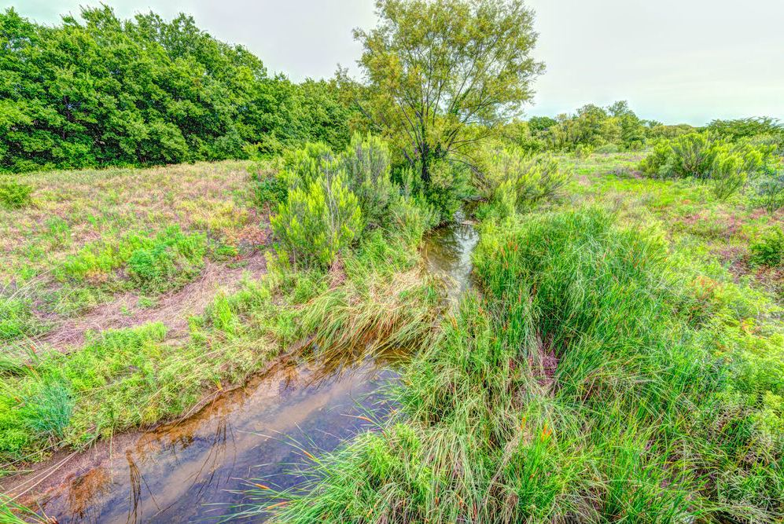
Definitions
Health: A flourishing condition, well-being, vitality, or prosperity (Webster).
photo credit: Luther Smith - www.luthersmith.us

Slide 7




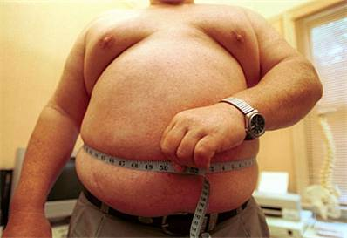



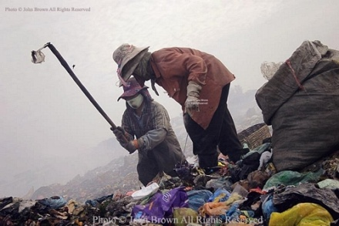
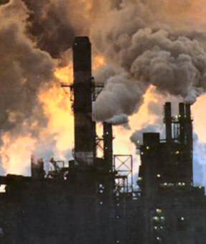

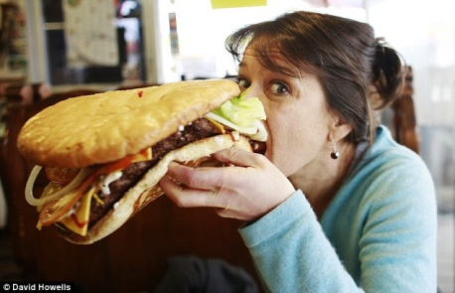

Unhealthy Condition
Unhealthy Context
Notes:
DEFINING HEALTH
SO WHAT DO WE INCLUDE WHEN WE TALK ABOUT HEALTH? Just like when we discuss human health, the health of the human body… we know that that looks like - and we know it is a connected system…
We know what healthy looks like, and we know what unhealthy looks like – it can be the current status (running a fever), unhealthy exposures and unhealthy behaviors that lead to impaired health, genetic predisposition, or location / context.
CONTEXT …… CONDITION

Slide 8
Nothing
alive
Severe
disturbance
Pristine
Gradient of biological condition
Gradient of human disturbance
No or
Minimal
disturbance
Unhealthy
Not sustainable
Healthy
Sustainable
Threshold
Biological
Integrity
At one end of a continuum of human influence on biological condition, severe disturbance eliminates all life. At the other end of the gradient are “pristine” or minimally disturbed living systems (top); these systems possess biological integrity. A parallel gradient (bottom) from integrity toward nothing alive passes through healthy, or sustainable conditions or activities. Below a threshold defined by specific criteria, the conditions or activities are no longer healthy or sustainable in terms of supporting living systems. (from Karr and Chu 1999).

Slide 9
Definitions
Sustainable water use: “the use of water that supports the ability of human society to endure and flourish into the indefinite future without undermining the integrity of the hydrological cycle or the ecological systems that depend on it.” Peter Gleick, cited by Richter (2014)
photo credit: Luther Smith - www.luthersmith.us

Slide 10

We cannot trust people to do the right thing, and not because they don’t want to . . .

Slide 11

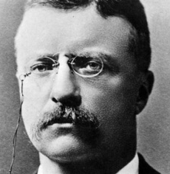
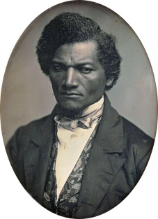

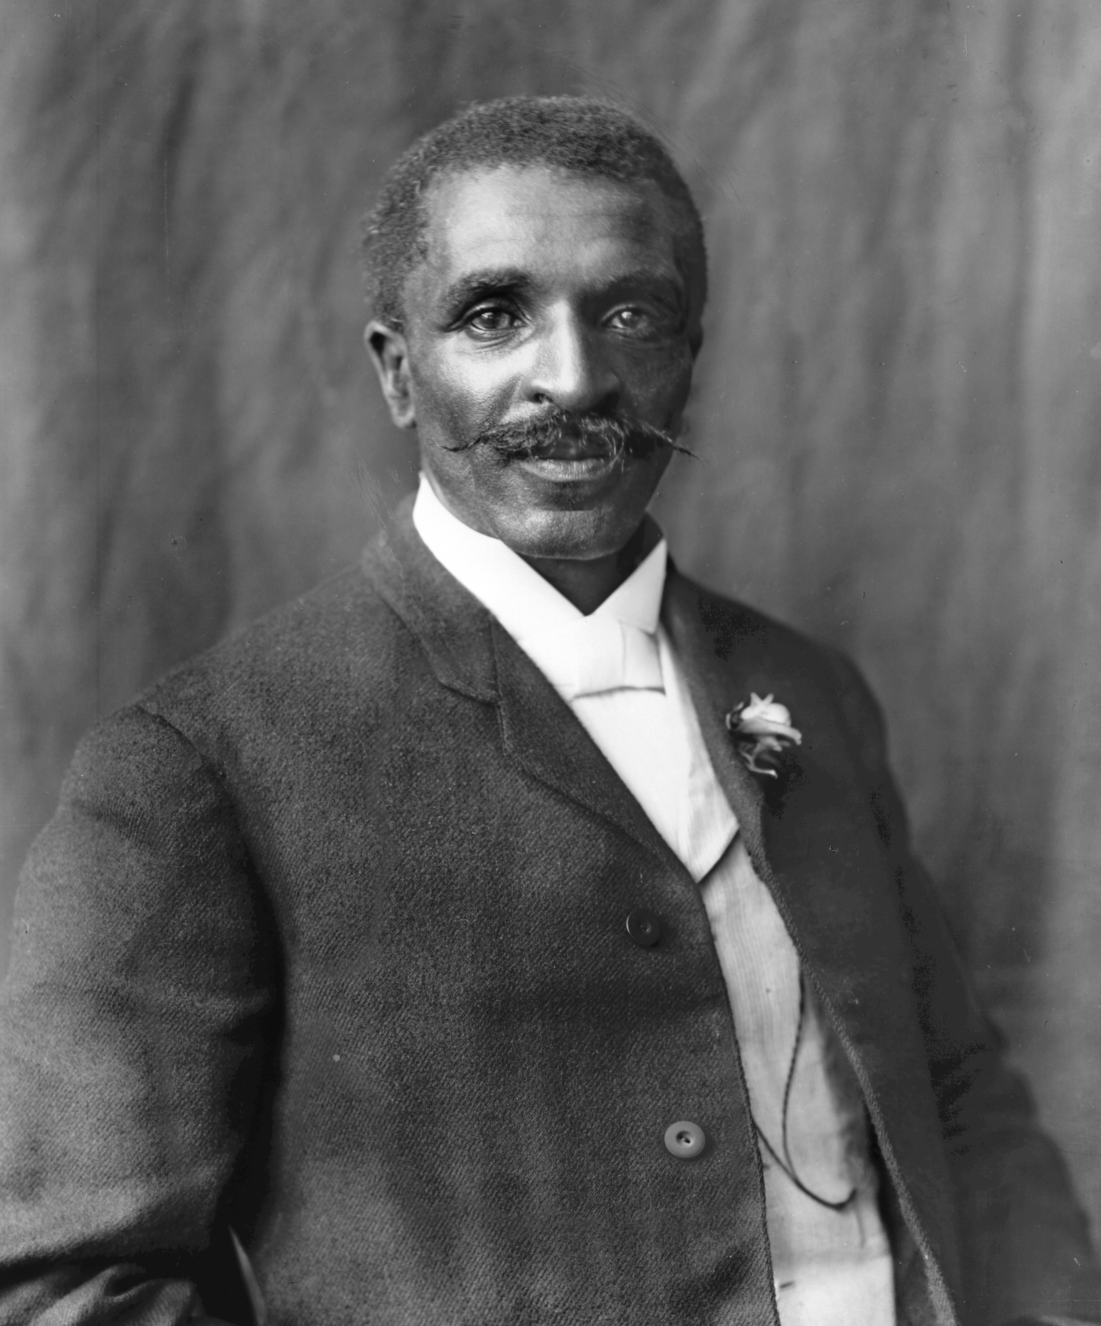
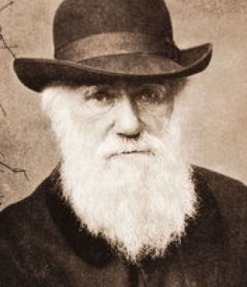
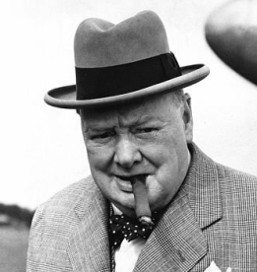



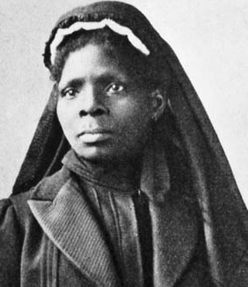
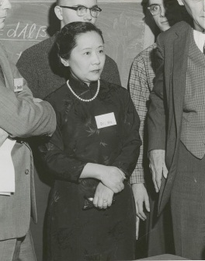
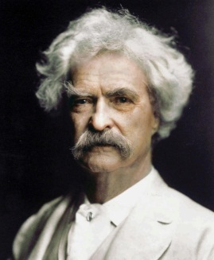


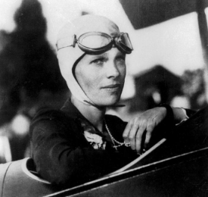

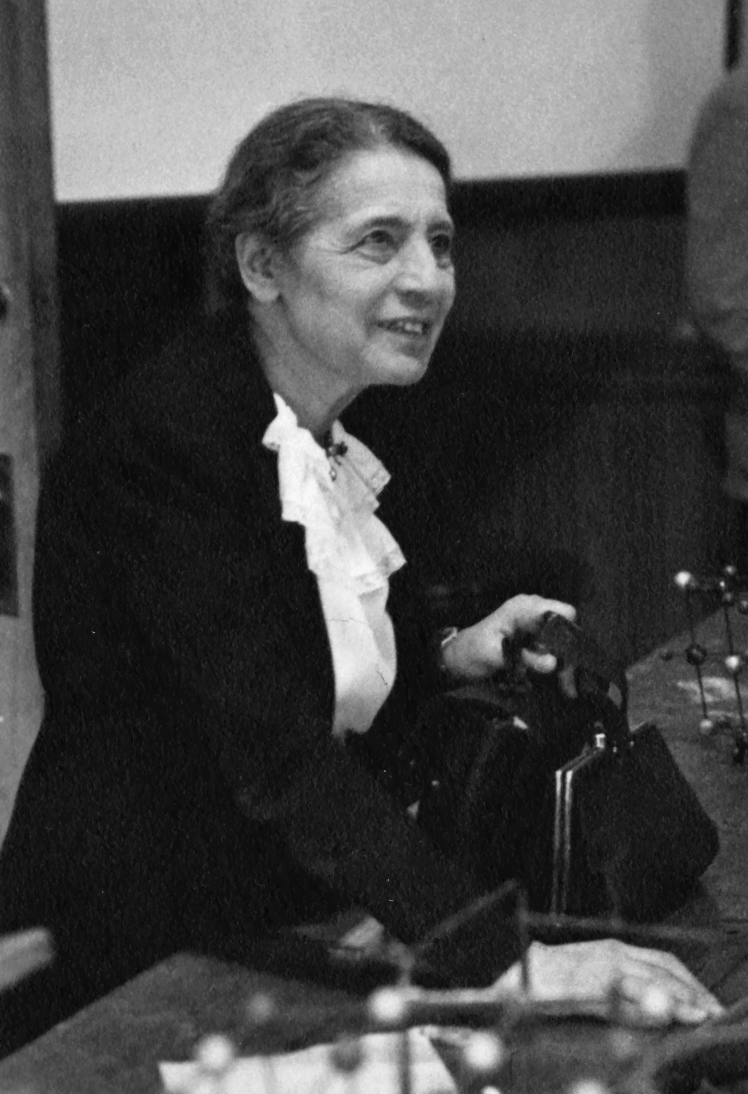

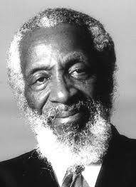

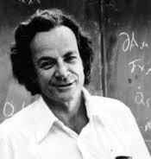

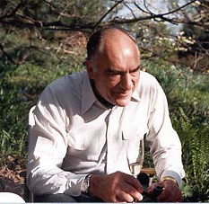
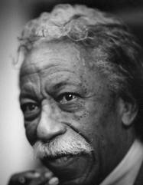

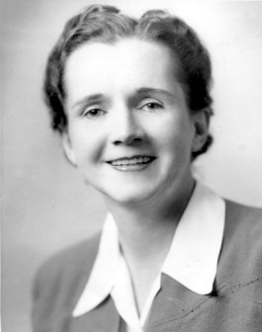



Bounded Rationality
Notes:
francis bacon, william shakespeare, galileo, chien-shiung-wu, fredrick douglass, lise meitner, gordan parks, george washington carver, albert einstein, herbert simon, salvador dali, samuel clemens, rosalind franklin, rachel carson, amelia earhart, richard feyman, maya angelou, nelson mandela, jimi hendricks, steven hawking, mother teresa, howard zinn, luna leopold, mae c. jemison, dick gregory

Slide 12
Bounded Rationality is the notion that in decision-making, rationality of individuals is limited by the information they have, the cognitive limitations of their minds, and the finite time they have to make a decision.
from: Herbert Simon; 1957, 1991.

Slide 13
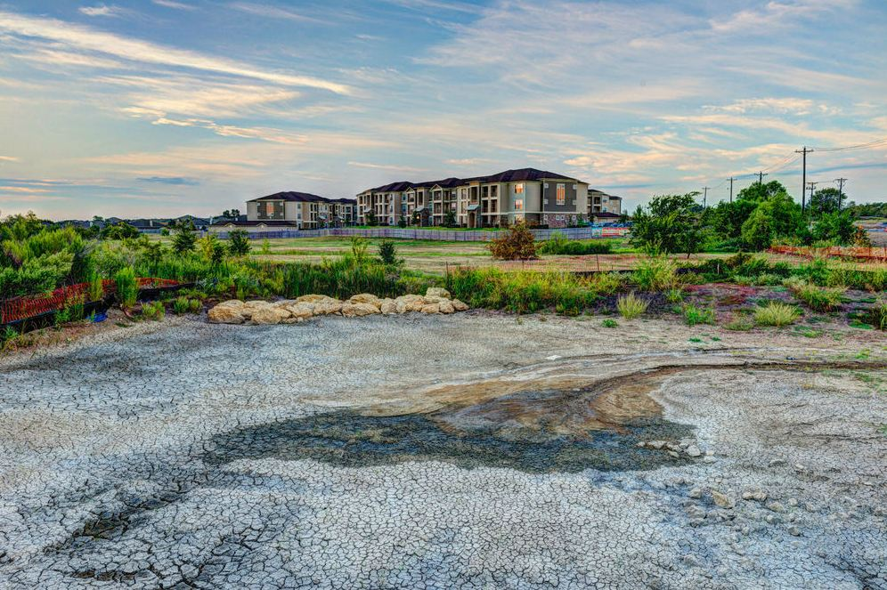
These factors limit the extent to which agents may make a fully rational decision, thus they possess only “bounded rationality” and must make decisions by “satisficing,” or choosing that which might not be optimal, but which will make them happy enough.
from: Herbert Simon; 1957, 1991; photo credit: Luther Smith, www.luthersmith@us

Slide 14
‘Upshot’: The bounded rationality of each actor in a system may not lead to decisions that further the welfare of the system as a whole.
from: Thinking in Systems, A Primer; Donella Meadows, 2008.
Notes:
Page106 bounded rationality means that people make quite reasonable decisions based on the information they have. But they don’t have perfect information, especially about more distant parts of the system. Fisherman don’t know how many fish there are, much less how many fish will be caught by other fisherman that same day. Businessmen don’t know for sure what other businessmen are planning to invest . . .
We are not omniscient, rational optimizers, says Herbert Simon (Nobel prize winning economist who coined the term). Rather, we are blundering “satisficers” attempting to meet (satisfy) our needs well enough (sufficiently) before moving on to the next decision. We do our best to further our own interests in a rational way, but we can take into account only what we know. We don’t know what others are planning to do, until they do it. We rarely see the full range of possibilities before us. We often don’t foresee (or choose to ignore) the impacts of our actions on the whole system. So instead of finding a long-term optimum, we discover within our limited purview a choice we can live with for now, and we stick to it, changing our behavior only when forced to. . . . We live in an exaggerated present – we pay too much attention to recent experience and too little attention to the past, focusing on current events rather than long-term behavior.

Slide 15
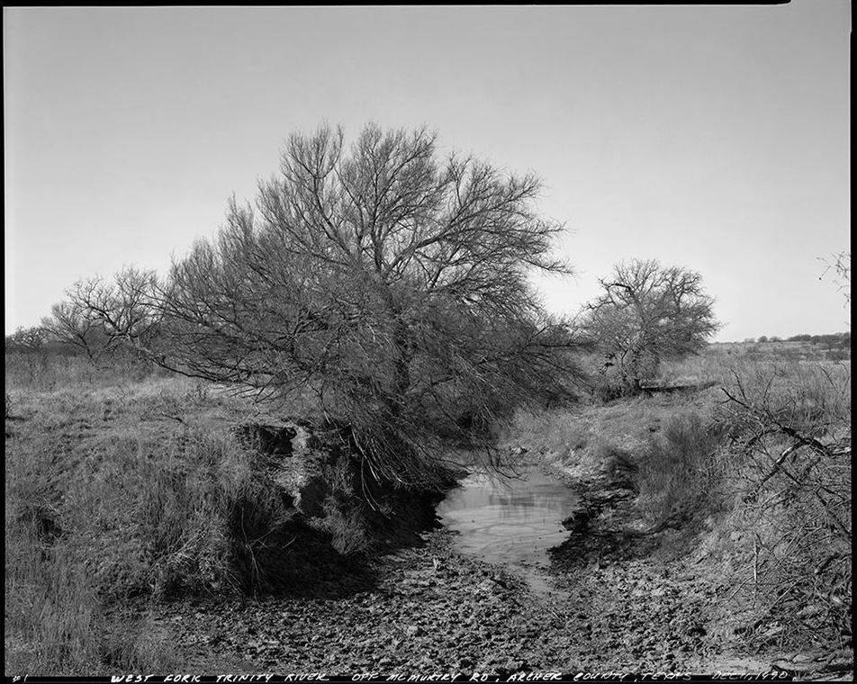
Putting new actors into the same system will not improve its performance. What makes a difference is redesigning the system to improve the information, incentives, disincentives, goals, stresses, and constraints that have an effect on specific actors.
from: Thinking in Systems, A Primer; Donella Meadows, 2008.
photo credit: Luther Smith - www.luthersmith.us
Notes:
West fork of the Trinity River, Archer County, Texas – Photo by Luther Smith

Slide 16

Out of context, the best minds
do the worst damage.
Wes Jackson (from Berry 2005)

Slide 17
General Workshop Outline
2
Context of Our Work
1
3
Goal
Systems
5
4
An Approach

Slide 18
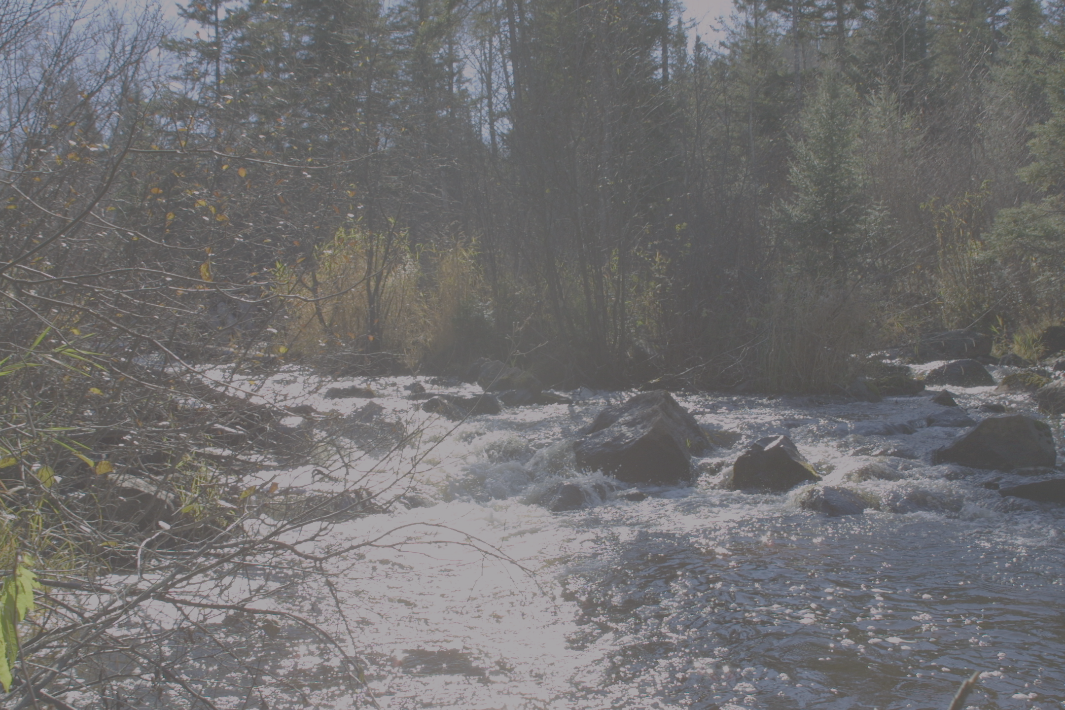
General Workshop Outline
2
Context of Our Work
Need For Water
1
Other Realities
Goal
Principles and Challenges

Slide 19
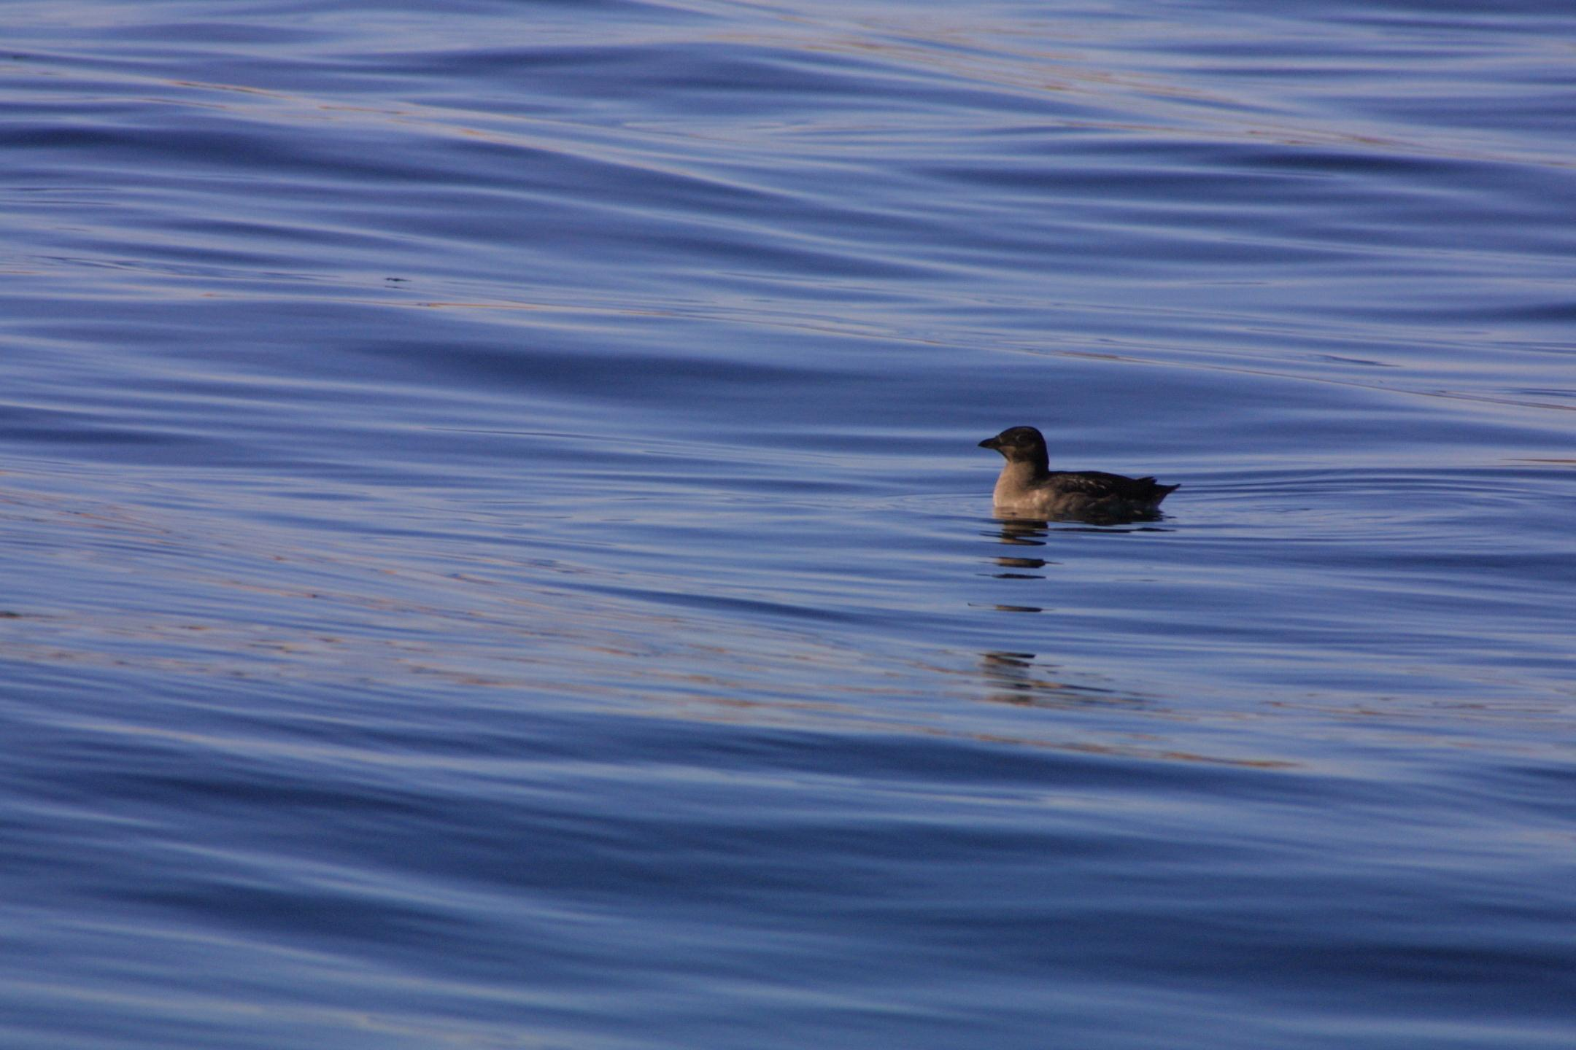
The Need for Water
The World’s Fresh Water
Water and Ecosystems
Food
Energy
adopted from Gleick (1993), Falkenmark and Rockström (2004)

Slide 20

Where is Earth’s Water?
Freshwater 2.5%
Surface/other freshwater 1.3%
Living things 0.83%
Rivers 2.1%
Swamps 11.5%
Other saline water 1%
Groundwater 30.1%
Atmosphere 12.9%
Soil 16.5%
Glaciers and ice caps 68.7%
Oceans 96.5%
Lakes 91%
Total Global Water
Freshwater
Surface Freshwater
and Other Freshwater
data from Shiklomanov (1993)

Slide 21
Where is Earth’s Water?
Living things 0.83%
Rivers 2.1%
Swamps 11.5%
Atmosphere 12.9%
Soil 16.5%
Lakes 91%
Surface Freshwater
and Other Freshwater
data from Shiklomanov (1993)

Slide 22
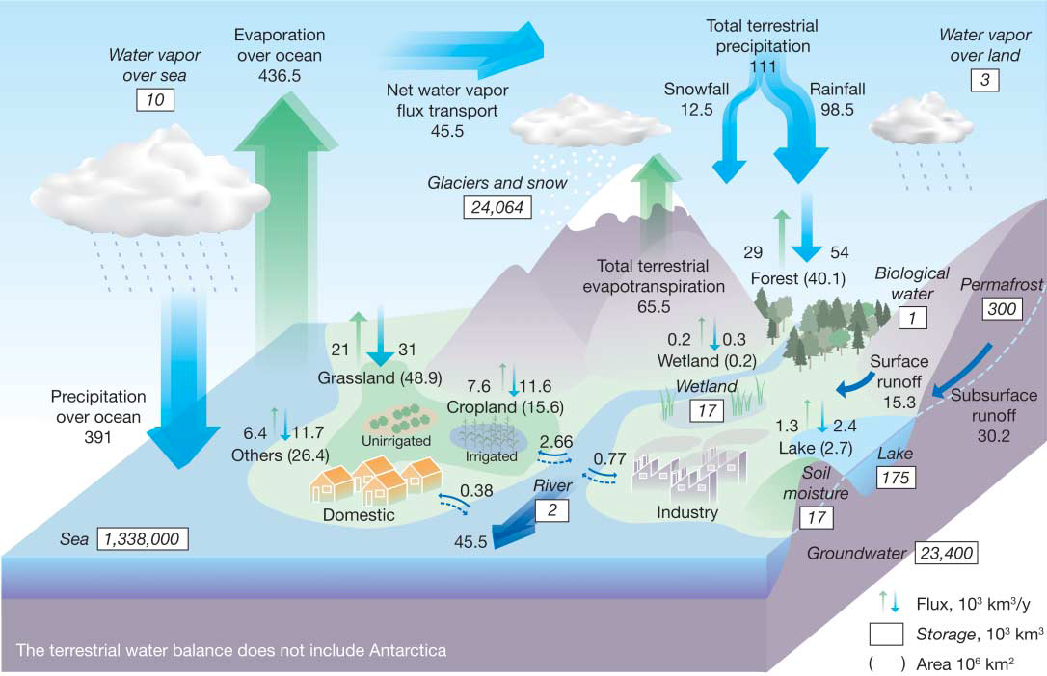
Global Hydrologic Fluxes – Water In Motion
from Oki and Kanae (2006)
Notes:
Global hydrological fluxes (1000 km3/year) and storages (1000 km3) with natural and anthropogenic cycles are synthesized from various sources (1, 3–5). Big vertical arrows show total annual precipitation and evapotranspiration over land and ocean (1000 km3/year), which include annual precipitation and evapotranspiration in major landscapes (1000 km3/year) presented by small vertical arrows; parentheses indicate area (million km2). The direct groundwater discharge, which is estimated to be about 10% of total river discharge globally (6), is included in river discharge

Slide 23
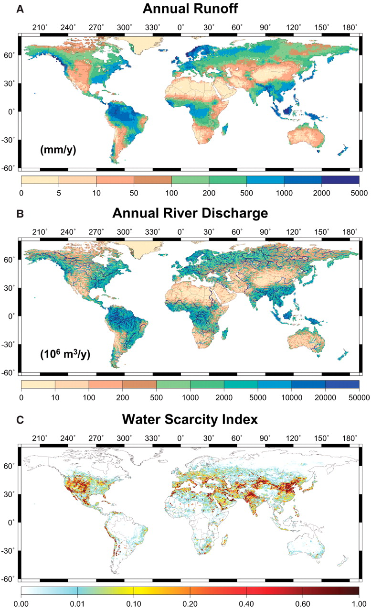

Global distribution of (A) mean annual runoff (mm/year).
from Oki and Kanae (2006)
Published by AAAS
Notes:
Global distribution of (A) mean annual runoff (mm/year), (B) mean annual discharge (million m³/year), and (C) water scarcity index Rws (3, 11). Water stress is higher for regions with larger Rws.

Slide 24
Global distribution of (B) mean annual discharge (million m3/year).
from Oki and Kanae (2006)
Published by AAAS
Notes:
Global distribution of (A) mean annual runoff (mm/year), (B) mean annual discharge (million m³/year), and (C) water scarcity index Rws (3, 11). Water stress is higher for regions with larger Rws.

Slide 25
Global distribution of the (C) water scarcity index Rws (3, 11).
from Oki and Kanae (2006)
Published by AAAS
Notes:
Global distribution of (A) mean annual runoff (mm/year), (B) mean annual discharge (million m³/year), and (C) water scarcity index Rws (3, 11). Water stress is higher for regions with larger Rws.

Slide 26
Even though the whole human enterprise – cities, industry, agriculture – is currently using only 12% of all the global freshwater flowing into and through the lakes, rivers and aquifers on a continual basis – shortages occur because of differences in availability in space and time.
Water scarcity is not global in its physical expression – it is highly localized.
There are two fundamental reasons for water shortages:
1) overuse of available water
2) lack of adequate governance providing long-term, equitable access to water.
from Richter (2014)

Slide 27
Global water use, by major sector
from:
Hoekstra and Mekonnen (2012)

Slide 28
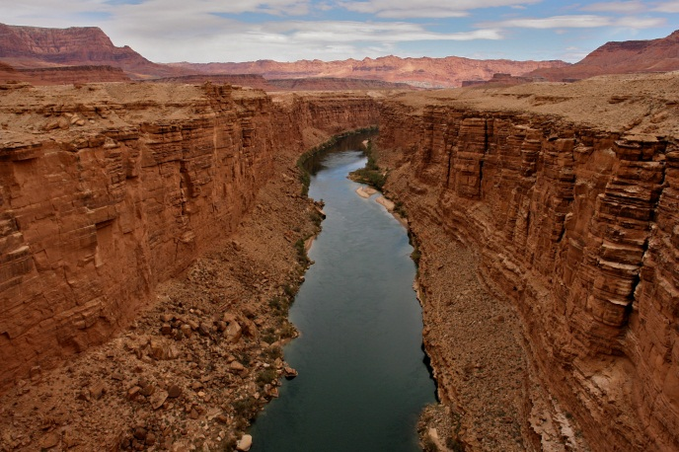
Global Water Footprint,
by
Types of Consumptive Use
(1998-2005)
9.1 trillion cubic meters/year
Internal water
footprint
78%
͌500X Q _{X annual}
from: Mekonnen and Hoekstra (2011)
Notes:
Between 1998-2005, the global water footprint (consumptive use) was about 9.1 trillion cubic meters (around 7.4 billion acre-feet) per year. That is about 500 times the average annual flow of the Colorado River in its natural state (Cohen et al. 2001, cited from The World’s Water, Volume 8, 2014, Peter Gleick). About 75% of the world’s water is green water (rainfall), 11 percent is blue water (surface and ground water), and 15 percent is grey water (water required to assimilate pollutant load, based on existing ambient water quality standards). Ninety-two percent is associated with consumption of agricultural products, while industrial products make up 5 percent, and direct water consumption makes up just 4 percent. Twenty-two percent of the global water footprint is “external”, meaning that it pertains to internationally traded products (cited from The World’s Water, Volume 8, 2014, Peter Gleick).

Slide 29
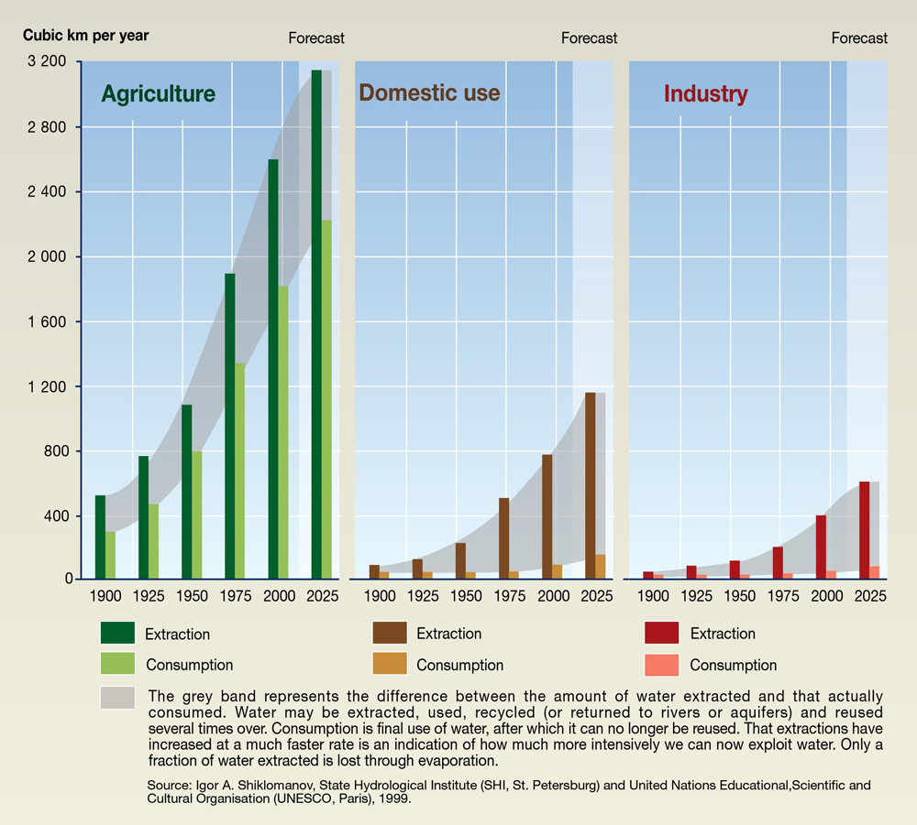
Trends in global water use by sector.

Slide 30
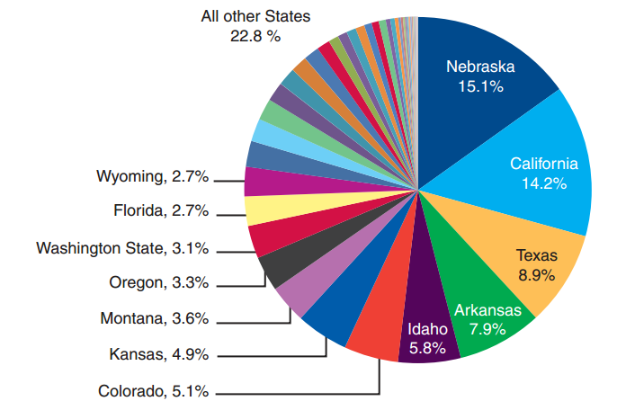
State Shares of Total U.S. Irrigated Acres (2007)
Twelve Leading Irrigation States (10 from the West, and Arkansas and Florida from the East), accounted for 77.3% of US Irrigated Acres.
Source: USDA, National Agricultural Statistics Service, 2007 Census of Agriculture, State Data, 2009.
Notes:
Twelve Leading Irrigation States (10 from the West, and Arkansas and Florida from the East), accounted for 77.3% of US Irrigated Acres, including harvested cropland, pasture and other lands.

Slide 31
The Need for Water
The World’s Fresh Water
Water and Ecosystems
Food
Energy
adopted from Gleick (1993), Falkenmark and Rockström (2004)

Slide 32
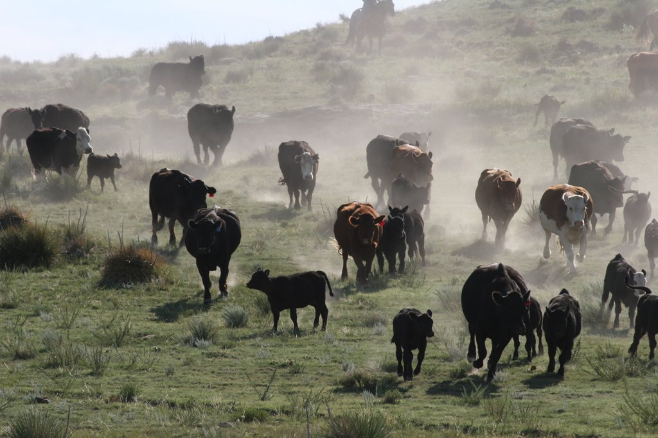


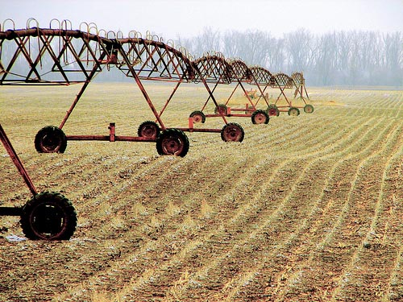
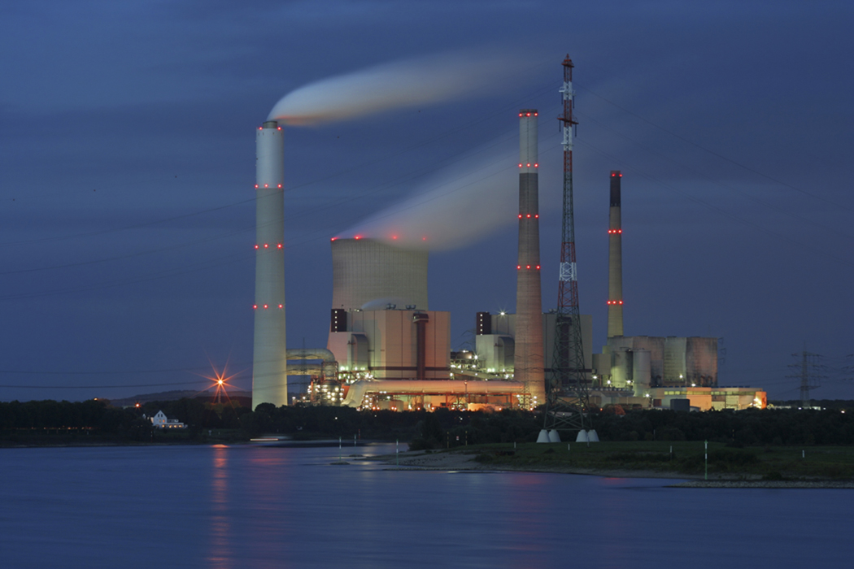
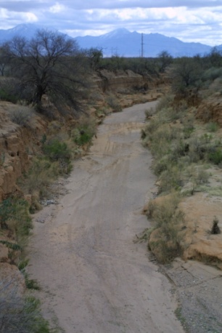
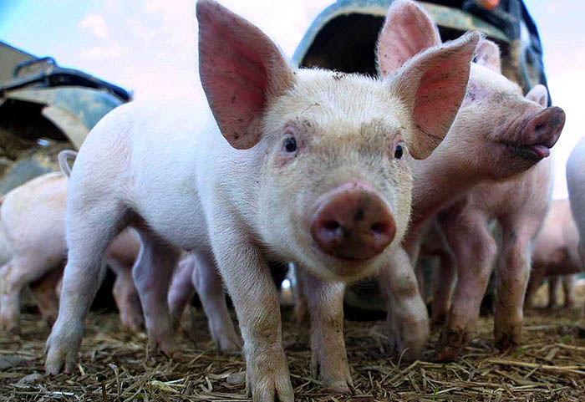
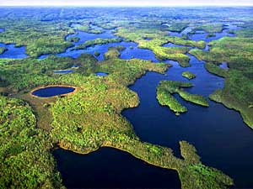
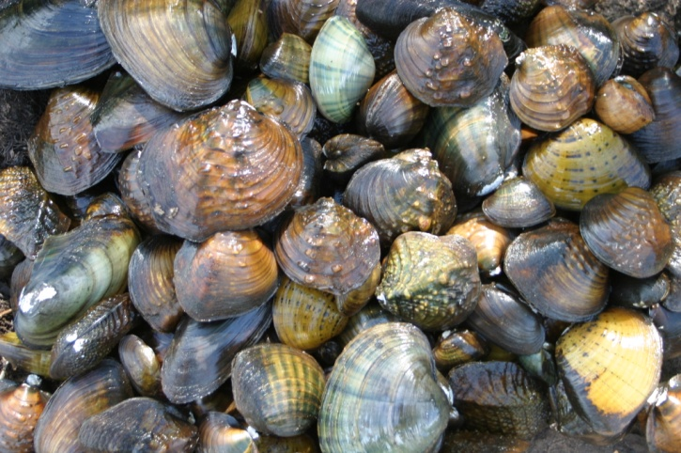
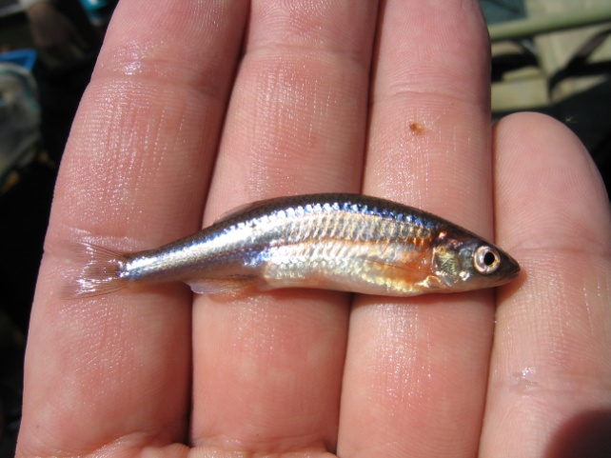


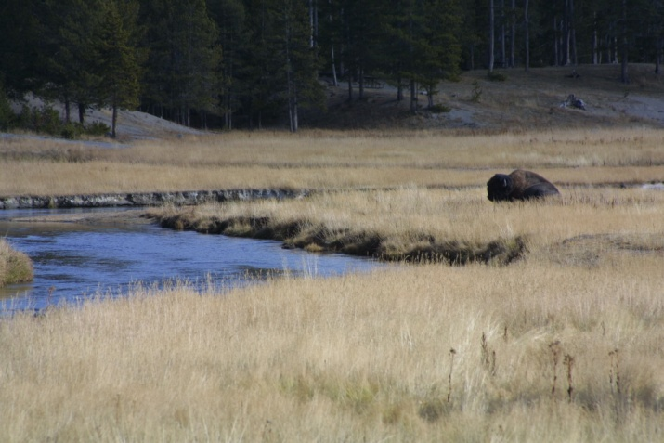
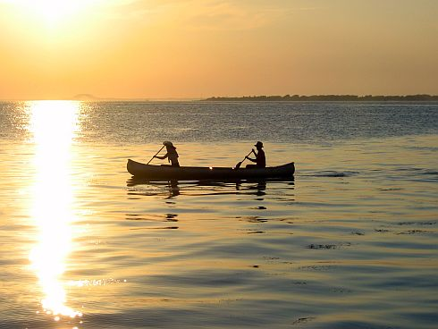
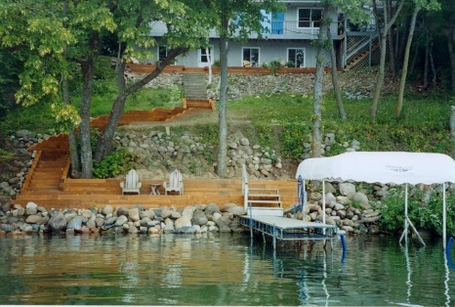
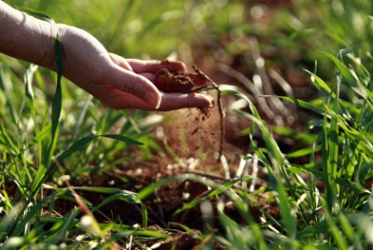
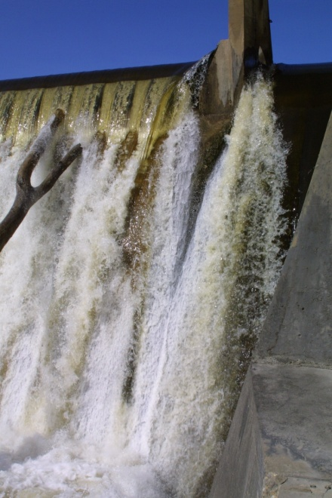
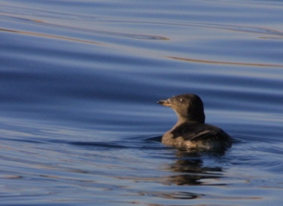
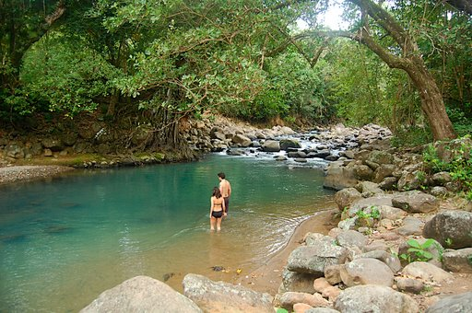
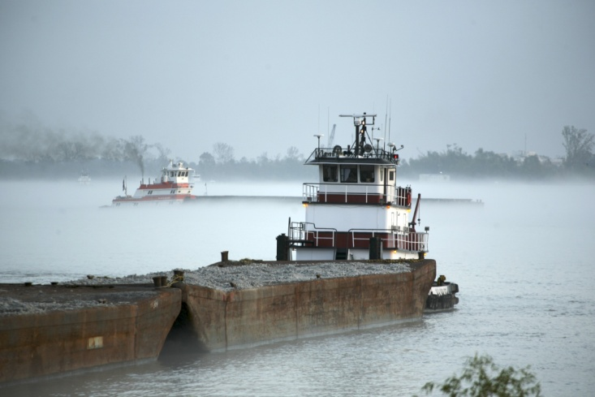
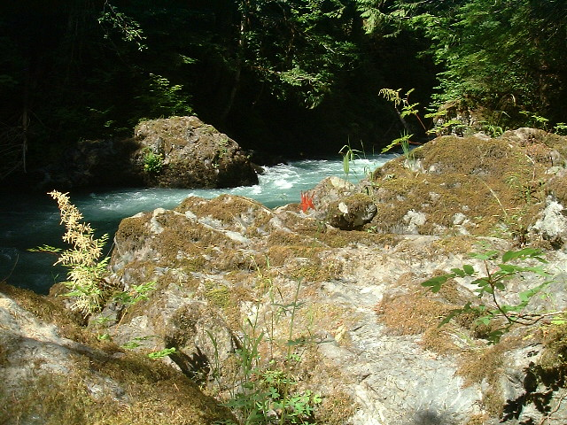
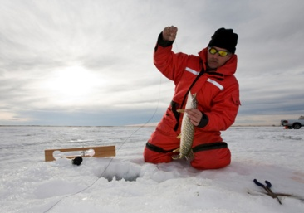
Notes:
What healthy rivers give us: Clean water, Habitat for plants, wildlife, and fish--many of direct benefit to humans, Storage of floodwaters in the floodplain and wetlands, reducing the magnitude and destructiveness of flooding, Transportation, from light canoes to fleets of barges, Power for mills and power plants, Removal of effluent, heat, and other waste, Beauty, spiritual significance, and even national identity.
New York city gets its drinking water from the Catskill Mountains. In the past, the relatively undisturbed watershed provided clean drinking water with no need to run it through a filtration plant. However, as the population in the mountains increased the water became less clean. NYC was left with the option of operating a filtration plant (3-8 billion) or protecting the watershed at a cheaper cost (Bill Moyer Report).

Slide 33
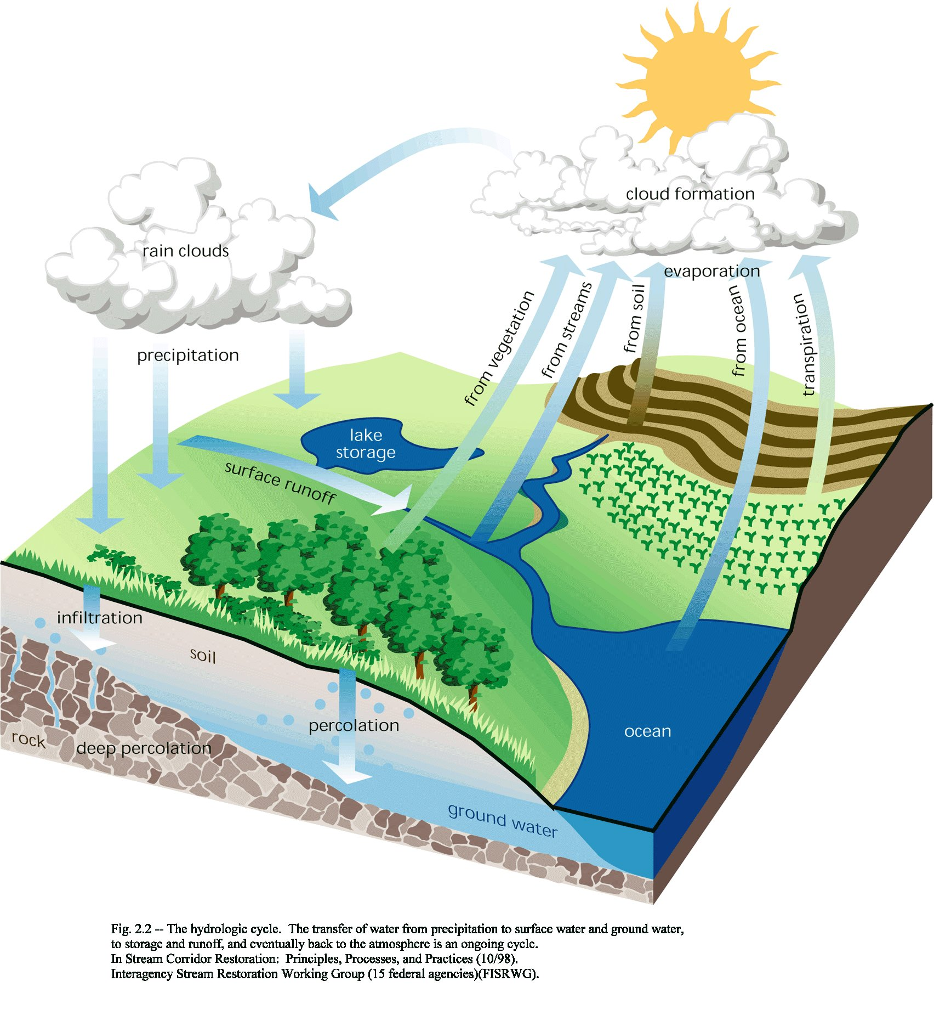
The Land
and Water
are
Intimately
Connected

Slide 34






ECOLOGY OF NATURAL SYSTEMS
Energy Pathways/ Connectivity
Biology
Hydrology
300
250
200
FLOW (cfs)
150
100
50
Geomorphology
0
J F M A M J J A S O N D
Water Quality
Month

Slide 35
Natural systems were built and are maintained by different magnitudes of discharge occurring over time and space. (Hill et al. 1991)
All flows (parts of the hydrograph), are essential to the ecological functioning of the system
Notes:
All parts of hydrograph important – there is no excess water
At low flows impact water quality
At mid flows impact biological instream habitat
At high flows can impact biological conditions in the riparian zone, and channel forming and maintenance is of concern

Slide 36

Bunn and Arthington (2002)
Notes:
Figure X. The natural flow regime influences aquatic biodiversity via several interrelated mechanisms operating over different spatial and temporal scales. The relationship between biodiversity and the physical nature of the aquatic habitat is likely to be driven primarily by large events that influence channel form and shape (principle 1). However, droughts and low-flow events are also likely to play a role by limiting overall habitat availability. Many features of the flow regime influence life history patterns, especially seasonality and predictability of the overall pattern, but also the timing of particular flow events (principle 2). Some flow events trigger longitudinal dispersal of migratory aquatic organisms and other large events allow access to otherwise disconnected floodplain habitats (principle 3). The native biota have evolved in response to the overall flow regime. Catchment landuse change and associated water resource development inevitably lead to changes in one or more aspects of the flow regime resulting in declines in aquatic biodiversity via these mechanisms. Invasions by introduced or exotic species are more likely to succeed at the expense of native biota if the former are adapted to the modified flow regime. Bunn and Arthington 2002).

Slide 37

Loss of Biodiversity
Considered the most severely exceeded planetary boundary of a safe operating space for humanity (Rockstrom et al. 2009).
Planetary Boundaries: the nine wedges represent an estimate of the current position of each boundary. The inner green shading represents the proposed safe operating space. Biodiversity loss, nitrogen cycle, and climate change have been transgressed (from Rockström et al. 2009).

Slide 38

Proportion of species at risk by plant and animal group
Source: Precious Heritage (2000) © TNC, NatureServe
Notes:
The result is what we see out there: freshwater organisms are the most imperiled group in the world

Slide 39

Global geography of incident threat to
human water security and biodiversity.
from: Vӧrӧsmarty et al. (2010)

Slide 40
The Need for Water
The World’s Fresh Water
Water and Ecosystems
Food
Energy
adopted from Gleick (1993), Falkenmark and Rockström (2004)

Slide 41

The (Sometimes) Forgotten
Connection . . . .
Food Supply & Water:
We eat a lot of water!

Slide 42

Human Direct Water Needs (m³/person/year)
 | Actual |  | Desired |  |  | % of total need
 | Range | Average | Developing | Developed | Global Average | Actual | Desired
Diet | 600-1800 | 1200 | 1300 | 1600 | 1350 | 88 | 90
Domestic | 20-40 | 30 | 30 | 30 | 30 | 2 | 2
Industry | 10-140 | 130 | 130 | 130 | 130 | 10 | 8
Total | 630-1980 | 1360 | 1460 | 1760 | 1510 | 100 | 100
from: Falkenmark and Rockstrӧm (2004)
Sources: Gleick (2000); Rockstrӧm et al. (1999); Shiklomanov (2000)

Slide 43

Americans use the most water per person

Slide 44

from: www.watersecurity.ca
Notes:
The Organisation for Economic Co-operation and Development (OECD) (French: Organisation de coopération et de développement économiques, OCDE) is an international economic organisation of 34 countries founded in 1961 to stimulate economic progress and world trade

Slide 45

In terms of net water consumption – including water used in agricultural imports – Europe imports hundreds of billions of cubic metres of water per year

Slide 46

Hunger on the Rise
World hunger and malnutrition were on the decline for much of the late 20th century. But after falling to 825 million in the mid-1990s the number of hungry people began to rise, reaching 915 million in 2008. In 2009 it jumped to over 1 billion. With a business-as-usual approach to agriculture, population, and energy, 1.2 billion or more people will be hungry by 2015.
from Lester Brown, “Plan B 4.0”, Earth Policy Institute, 2009
Photo Credit: iStockPhoto / Claudia Dewald

Slide 47




Slide 48


from http://wattsupwiththat.com/2011/10/08/peak-oil-climate-change-and-the-threat-to-food-security/

Slide 49
The Need for Water
The World’s Fresh Water
Water and Ecosystems
Food
Energy
adopted from Gleick (1993), Falkenmark and Rockström (2004)

Slide 50

Water consumption estimates for different electricity generation methods (from Meldrum et al. 2013).
Thermoelectric generating requires the most water, wind and photovoltaics the least, when viewed at the life cycle level.
Notes:
Thermoelectric generating technologies require the most water, photovoltaics and wind the least, when viewed at the life cycle level. this means they can be vulnerable to constraints caused by drought conditions or other changes in water resources directly (for operations), but also indirectly, due to water required throughout fuel supply chains and power plant equipment life cycles. For example, the 2011 drought in Texas not only impacted actual and expected statewide generation (Saathoff 2011) but also led to temporary shutdowns of hydraulic fracturing and other natural gas extraction operations (Carroll 2011, Passwaters 2011). Despite relatively low operational water demands
compared to other generation technologies, photovoltaic and wind generation technologies also require water during manufacturing and construction.

Slide 51

Water Use in the U.S., 2005.
Irrigation: consumed ≈69% of withdrawal,
75% of total water consumed
Power Production: consumed ≈6.5% of withdrawal,
11% of total water consumed
Energy Production Uses More Water,
but ‘Consumes’ Less – with Caveats . . .
Source: Department of Energy, Lawrence Livermore National Labs, 2011 (Data from USGS Circular 1344, 2009)
Notes:
from McMahon and Price (2011):
Summary Points
1. Water and energy are strongly dependent on one another.
2. Development of bioenergy increases water and energy interdependence.
3. Most thermoelectric plants require water for cooling.
4. Closed-loop, dry, and hybrid cooling systems are replacing more water-intensive once-through
systems, reducing water withdrawals, and—except for dry cooling—increasing water
consumption.
5. Water requirements are minimal for electricity from wind and solar photovoltaic technologies.
6. Energy is used for pumping, treating, and desalinating water.
7. Significant energy and water savings are possible for industrial, commercial, and residential end
uses from efficient technologies and behaviors.
8. Addressing the interdependence of water and energy requires increased integrated resource
planning, collocation of water and energy facilities, and systems thinking at multiple scales.

Slide 52

Global analysis of water consumption for energy production (WCEP)
from http://cwee.ucdavis.edu/research/a-thirst-for-power/
Notes:
While agriculture dominates water demand in many regions of the world, the energy sector has become a major competitor. In the United States, there is a relatively even split between water withdrawals for irrigating crops (40% of total) and for cooling thermoelectric power plants (39%). Despite the potential impact of energy policy decisions on regional water security, few metrics are available to help us assess the water burden of national energy portfolios. To address this knowledge gap, CWEE researchers developed a global distribution of water consumption by national-level energy portfolio, calculating a water consumption for energy production (WCEP) indicator to compare 158 national energy systems’ water use across all energy categories, including fossil, nuclear, and biofuels, as well as electricity production. Just as monitoring greenhouse gas emissions is the first step to transforming energy portfolios to mitigate climate change, improved indicators for water consumption are required to balance the water impacts of long-term energy planning. Spang 2015

Slide 53
Notes:
Relationship between Energy Consumption and Human Development Index. Data from [106,107]. from Slaus and Jacobs 2011.
106. US Energy Information Administration, EIA. International Total Primary Energy Consumption and Energy Intensity. Available online: http://www.eia.doe.gov/emeu/international/ energyconsumption.html (accessed on 22 May 2010).
107. Human Development Report 2010; Palgrave Macmillan: Hampshire, UK, 2010.

Slide 54

Other Realities
Population Growth
Water Quality and Health
adopted from Gleick (1993), Falkenmark and Rockström (2004)

Slide 55

World Population Growth:
Currently (March 2015), 7.3 billion of us
and counting . . .
Overall numbers of people are going up, while the rate of increase is dropping:
from 1960, when the rate of increase was over 2%/year, it is expected to drop to an increase of 0.5%/year by 2050.

Slide 56
History of Human Population Growth
Years Elapsed | Year | Population
3,000,000 | 10,000 B.C. (Agricultural Revolution) | 5-10 Million
10,000 | 1 A.D. | 170 Million
1,800 | 1800 (Industrial Revolution) | 1 Billion
130 | 1930 | 2 Billion
30 | 1960 | 3 Billion
15 | 1975 | 4 Billion
12 | 1987 | 5 Billion
12 | 1999 | 6 Billion
12 | 2011 | 7 Billion

Slide 57

Global Distribution of Human Population

Slide 58


Slide 59


Slide 60


Number and percent urban population in more developed regions and less developed regions (drawn from World Urbanization Prospects, the 2011 Revision, UN 2012).
Major water issues of urban growth: bringing more water, and disposing of wastewater.
Graph of urban growth rates by size class; World Urbanization Prospects, the 2014 Revision, UN 2014).

Slide 61

Population-driven energy demand for water likely to increase in relatively dry areas.

Slide 62
Other Realities
Population Growth
Water Quality and Health
adopted from Gleick (1993), Falkenmark and Rockström (2004)

Slide 63


Land Cover – 1990s
Land Cover – Early 1800s
Land Cover – 1990s
Urban
Cultivated
Prairie
Coniferous Forest
Deciduous Forest
Mixed Forest
Open Water
Wetland

Slide 65

The Mississippi River carries some 550 million metric tons of sediment into the Gulf of Mexico each year.
from: Cheryl Lyn Dybas BioScience .2005;55:552-557
Notes:
The Mississippi River carries some 550 million metric tons of sediment into the Gulf of Mexico each year. This true-color image, acquired from the moderate resolution imaging spectroradiometer (MODIS) aboard NASA's Terra satellite, shows the murky brown water of the Mississippi mixing with the dark blue water of the gulf two days after a rainstorm. The river brings enough sediment from its 3,250,000-square-kilometer basin to extend the coast of Louisiana 91 meters each year. Image courtesy of Liam Gumley, Space Science and Engineering Center, University of Wisconsin-Madison, and the MODIS science team.

Slide 66
Percentage of stream nutrient load delivered
to the Gulf of Mexico from the Mississippi and Atchafalaya River Basin, (1992-2002)
(A) Total nitrogen
(B) Total phosphorus
from Alexander et al. (2008)
Notes:
Percentage of stream nutrient load delivered to the Gulf of Mexico from the incremental drainage of MARB reaches: (a)
total nitrogen; (b) total phosphorus.

Slide 67

URL: http://water.usgs.gov/nawqa/sparrow/gulf_findings/primary_sources.html

Slide 68


Estimated Agricultural Use for Atrazine, 2012
Source:
National Water Quality Assessment Program;
Pesticide National Synthesis Project
USGS Report DS 752, USGS Report DS 907

Slide 69

Global distribution of 400-plus systems that have scientifically reported accounts of being eutrophication associated dead zones. Their distribution matches the global human footprint (the normalized human influence is expressed as a percent (41)) in the Northern Hemisphere. For the Southern Hemisphere, the occurrence of dead zones is only recently being reported. from Diaz and Rosenberg (2008)

Slide 70



Slide 71

Low-oxygen water in the summer of 1990 killed fish and other marine life near the beach at Grand Isle, Louisiana.
Are We Simply Trading Productivity in One Area for Another? What Other Costs Are There?
from: Cheryl Lyn Dybas BioScience 2005;55:552-557
Notes:
Low-oxygen water in the summer of 1990 killed fish and other marine life near the beach at Grand Isle, Louisiana. The fish were bottom dwellers like red drum, black drum, croaker, sea catfish, skate, and flounder. Brown shrimp, which also live on the bottom, were killed along with the many fish species. Photograph: Kerry M. St. Pé, Barataria Terrebonne National Estuary Program.

Slide 72

Principles and Challenges
Society and Ecosystems Share the Same Water
Water and Politics
Climate Change
adopted from Gleick (1993), Falkenmark and Rockström (2004)

Slide 73

Human Health = Ecosystem Health

Slide 74

Altered flows leads to ecological degradation in streams across the U.S. (90% of assessed streams).
from: Carlisle et al. (2010)
Notes:
The amount of water flowing in streams and rivers has been significantly altered in nearly 90 percent of waters that were assessed in a new nationwide USGS study. Flow alterations are a primary contributor to degraded river ecosystems and loss of native species.
The full study and findings can be accessed at: http://water.ugs.gov/nawqa/pubs/Carlisleetal_FLowAlterationUS.pdf

Slide 75
Loss of Biodiversity
Considered the most severely exceeded planetary boundary of a safe operating space for humanity (Rockstrom et al. 2009).
Planetary Boundaries: the nine wedges represent an estimate of the current position of each boundary. The inner green shading represents the proposed safe operating space. Biodiversity loss, nitrogen cycle, and climate change have been transgressed (from Rockström et al. 2009).

Slide 76

from Liu et al. (2007)
Changes in the numbers of natural disasters and people affected (modified from Centre
for Research on the Epidemiology of Disasters 2005).

Slide 77
Principles and Challenges
Society and Ecosystems Share the Same Water
Water and Politics
Climate Change
adopted from Gleick (1993), Falkenmark and Rockström (2004)

Slide 78


Slide 79



Three Phases of Management;
(recognizing where we are)
1. Expand Supply
      “get more water”
from Ohlsson and Turton 2003
Notes:
The Turning of the Screw;

Slide 80


Three Phases of Management;
(recognizing where we are)
2. Increase efficiency of use(s)
  Requires Institutional Change
    “get more use out of every drop”
from Ohlsson and Turton 2003
Notes:
The Turning of the Screw;

Slide 81



Three Phases of Management;
(recognizing where we are)
3. Large-scale Social restructuring
  Focus on Allocation efficiency
  “decide who gets the drops”
from Ohlsson and Turton 2003
Notes:
The Turning of the Screw; Social resource scarcity as a bottle-neck in adaptation to water scarcity

Slide 82


Slide 83

Number of reported water conflict events per year, 1931–2012 averaged over two-year periods to smooth for cross-year events and uneven reporting).
from Gleick and Heberger (2014)

Slide 84

Incidence of reported water-related conflicts for transnational events (solid line) and subnational events (dashed line). In the past two decades, water conflicts have been dominated by subnational disputes.
from Gleick and Heberger (2014)

Slide 85
Principles and Challenges
Society and Ecosystems Share the Same Water
Water and Politics
Climate Change
adopted from Gleick (1993), Falkenmark and Rockström (2004)

Slide 86

Comparison of observed and simulated change in continental surface temperatures on land (yellow panels), Arctic and Antarctic September sea ice extent (white panels), and upper ocean heat content in the major ocean basins (blue panels). Anomalies are given relative to 1880–1919 for surface temperatures, to 1960–1980 for ocean heat content, and to 1979–1999 for sea ice.
from: IPCC, 2014: Climate Change 2014: Synthesis Report.
Notes:
Figure 1.10 | Comparison of observed and simulated change in continental surface temperatures on land (yellow panels), Arctic and Antarctic September sea ice extent (white panels), and upper ocean heat content in the major ocean basins (blue panels). Global average changes are also given. Anomalies are given relative to 1880–1919 for surface temperatures, to 1960–1980 for ocean heat content, and to 1979–1999 for sea ice. All time series are decadal averages, plotted at the centre of the decade. For temperature panels, observations are dashed lines if the spatial coverage of areas being examined is below 50%. For ocean heat content and sea ice panels, the solid lines are where the coverage of data is good and higher in quality, and the dashed lines are where the data coverage is only adequate, and, thus, uncertainty is larger (note that different lines indicate different data sets; for details, see WGI Figure SPM.6). Model results shown are Coupled Model Intercomparison Project Phase 5 (CMIP5) multi-model ensemble ranges, with shaded bands indicating the 5 to 95% confidence intervals. {WGI Figure SPM 6; for detail, see WGI Figure TS.12}
IPCC, 2014: Climate Change 2014: Synthesis Report. Contribution of Working Groups I, II and III to the Fifth Assessment Report of the Intergovernmental Panel on Climate Change [Core Writing Team, R.K. Pachauri and L.A. Meyer (eds.)]. IPCC, Geneva, Switzerland, 151 p

Slide 87

from: IPCC, 2014: Climate Change 2014: Synthesis Report.
It is extremely likely that more than half of the observed
increase in global average surface temperature from 1951 to
2010 was caused by the anthropogenic increase in GHG concentrations and other anthropogenic forcings together.
Notes:
Figure 1.9 | Assessed likely ranges (whiskers) and their mid-points (bars) for warming trends over the 1951–2010 period from well-mixed greenhouse gases, other anthropogenic forcings (including the cooling effect of aerosols and the effect of land use change), combined anthropogenic forcings, natural forcings, and natural internal climate variability (which is the element of climate variability that arises spontaneously within the climate system, even in the absence of forcings). The observed surface temperature change is shown in black, with the 5 to 95% uncertainty range due to observational uncertainty. The attributed warming ranges (colours) are based on observations combined with climate model simulations, in order to estimate the contribution by an individual external forcing to the observed warming. The contribution from the combined anthropogenic forcings can be estimated with less uncertainty than the separate contributions from greenhouse gases and other anthropogenic forcings separately. This is because these two contributions partially compensate, resulting in a signal that is better constrained by observations. {Based on Figure WGI TS.10 }
IPCC, 2014: Climate Change 2014: Synthesis Report. Contribution of Working Groups I, II and III to the Fifth Assessment Report of the Intergovernmental Panel on Climate Change [Core Writing Team, R.K. Pachauri and L.A. Meyer (eds.)]. IPCC, Geneva, Switzerland, 151 p

Slide 88

The atmosphere (a), (b), and ocean have warmed, the amounts of snow and ice have diminished (c), the sea level has risen (d), and ocean pH has decreased. Projections for RCP2.6 (blue) and RCP8.5 (red) are shown, with associated uncertainty, to 2100 & 2300 (a).
from: IPCC, 2014: Climate Change 2014: Synthesis Report.
Notes:
Figure 2.1 | (a) Time series of global annual change in mean surface temperature for the 1900–2300 period (relative to 1986–2005) from Coupled Model Intercomparison Project Phase 5 (CMIP5) concentration-driven experiments. Projections are shown for the multi-model mean (solid lines) and the 5 to 95% range across the distribution of individual models (shading). Grey lines and shading represent the CMIP5 historical simulations. Discontinuities at 2100 are due to different numbers of models performing the extension runs beyond the 21st century and have no physical meaning. (b) Same as (a) but for the 2006–2100 period (relative to 1986–2005). (c) Change in Northern Hemisphere September sea-ice extent (5 year running mean). The dashed line represents nearly ice-free conditions (i.e., when September sea-ice extent is less than 106 km2 for at least five consecutive years). (d) Change in global mean sea level. (e) Change in ocean surface pH. For all panels, time series of projections and a measure of uncertainty (shading) are shown for scenarios RCP2.6 (blue) and RCP8.5 (red). The number of CMIP5 models used to calculate the multi-model mean is indicated. The mean and associated uncertainties averaged over the 2081–2100 period are given for all RCP scenarios as coloured vertical bars on the right hand side of panels (b) to (e). For sea-ice extent (c), the projected mean and uncertainty (minimum–maximum range) is only given for the subset of models that most closely reproduce the climatological mean state and the 1979–2012 trend in the Arctic sea ice. For sea level (d), based on current understanding (from observations, physical understanding and modelling), only the collapse of marine-based sectors of the Antarctic ice sheet, if initiated, could cause global mean sea level to rise substantially above the likely range during the 21st century. However, there is medium confidence that this additional contribution would not exceed several tenths of a meter of sea level rise during the 21st century. {WGI Figure SPM.7, Figure SPM.9, Figure 12.5, 6.4.4, 12.4.1, 13.4.4, 13.5.1}
IPCC, 2014: Climate Change 2014: Synthesis Report. Contribution of Working Groups I, II and III to the Fifth Assessment Report of the Intergovernmental Panel on Climate Change [Core Writing Team, R.K. Pachauri and L.A. Meyer (eds.)]. IPCC, Geneva, Switzerland, 151 p

Slide 89

Global climate in 2081-2100, relative to today (1986-2005) for 2 scenarios.
The number of models used to calculate the mean is indicated in the upper right corner of each panel. Dots indicate large projected change (>2SD of NV) and 90% model agreement, hatching shows regions where change is less (<1SD).
from: IPCC, 2014: Climate Change 2014: Synthesis Report.
Notes:
Figure 2.2 | Coupled Model Intercomparison Project Phase 5 (CMIP5) multi-model mean projections (i.e., the average of the model projections available) for the 2081–2100
period under the RCP2.6 (left) and RCP8.5 (right) scenarios for (a) change in annual mean surface temperature and (b) change in annual mean precipitation, in percentages, and
(c) change in average sea level. Changes are shown relative to the 1986–2005 period. The number of CMIP5 models used to calculate the multi-model mean is indicated in the
upper right corner of each panel. Stippling (dots) on (a) and (b) indicates regions where the projected change is large compared to natural internal variability (i.e., greater than two
standard deviations of internal variability in 20-year means) and where 90% of the models agree on the sign of change. Hatching (diagonal lines) on (a) and (b) shows regions
where the projected change is less than one standard deviation of natural internal variability in 20-year means. {WGI Figure SPM.8, Figure 13.20, Box 12.1}
IPCC, 2014: Climate Change 2014: Synthesis Report. Contribution of Working Groups I, II and III to the Fifth Assessment Report of the Intergovernmental Panel on Climate Change [Core Writing Team, R.K. Pachauri and L.A. Meyer (eds.)]. IPCC, Geneva, Switzerland, 151 p

Slide 90



Relative change in annual discharge for a 2°C and a 3°C world in the 2040s - 2070s respectively, relative to the 1980–2010
period based on the ISI-MIP modeling framework. from Schewe et al. (2014).
2° C
Colors indicate the multi-model mean change; the saturation of colors indicates the agreement across the model ensemble. More saturated colors indicate higher model agreement.
3° C
Water Scarcity Projected to Intensify . . .
Notes:
Note a strong negative trend in Mesoamerica at the 3 C global meaning warming. We show that climate change is likely to exacerbate regional and global water scarcity considerably. In particular, the ensemble average projects that a global warming of 2 °C above present (approximately 2.7 °C above preindustrial) will confront an additional approximate 15% of the global population with a severe decrease in water resources and will increase the number of people living under absolute water scarcity (<500 m3 per capita per year) by another 40% (according to some models, more than 100%) compared with the effect of population growth alone.
In the framework of the Inter-Sectoral Impact Model Intercomparison Project [ISI-MIP; Warszawski et al. (14) in this issue of PNAS] a set of nine global hydrological models, one global land-surface model, and one dynamic global vegetation model [here summarized as global hydrological models (GHMs); Materials and Methods ] has been applied using bias-corrected forcing from five different global climate models (GCMs) under the newly developed Representative Concentration Pathways (RCPs).

Slide 91

Based on the available scientific literature since the IPCC Fourth Assessment Report (AR4), there are substantially more impacts in recent decades now attributed to climate change.
from: IPCC, 2014: Climate Change 2014: Synthesis Report.
Notes:
Based on the available scientific literature since the IPCC Fourth Assessment Report (AR4), there are substantially more impacts in recent decades now attributed to climate change. Attribution requires defined scientific evidence on the role of climate change. Absence from the map of additional impacts attributed to climate change does not imply that such impacts have not occurred. The publications supporting attributed impacts reflect a
growing knowledge base, but publications are still limited for many regions, systems and processes, highlighting gaps in data and studies. Symbols indicate categories of attributed impacts, the relative contribution of climate change (major or minor) to the observed impact and confidence in attribution. Each symbol refers to one or more entries in WGII Table SPM.A1, grouping related regional-scale impacts. Numbers in ovals indicate regional totals of climate change publications from 2001 to 2010, based on the Scopus bibliographic database for publications in English with individual countries mentioned in title, abstract or key words (as of July 2011). These numbers provide an overall measure of the available scientific literature on climate change across regions; they do not indicate the number of publications supporting attribution of climate change impacts in each region. Studies for polar regions and small islands are grouped with neighbouring continental regions. The inclusion of publications for assessment of attribution followed IPCC scientific evidence criteria defined in WGII Chapter 18. Publications considered in the attribution analyses come from a broader range of literature assessed in the WGII AR5. See WGII Table SPM.A1 for descriptions of the attributed impacts. {Figure 1.11}
IPCC, 2014: Climate Change 2014: Synthesis Report. Contribution of Working Groups I, II and III to the Fifth Assessment Report of the Intergovernmental Panel on Climate Change [Core Writing Team, R.K. Pachauri and L.A. Meyer (eds.)]. IPCC, Geneva, Switzerland, 151 p

Slide 92

Summary of projected changes in crop yields (mostly wheat, corn, rice, and soy) due to climate change over the 21st century.
from: IPCC, 2014: Climate Change 2014: Synthesis Report.
Notes:
Figure 2.7 | Summary of projected changes in crop yields (mostly wheat, maize, rice and soy) due to climate change over the 21st century. The figure combines 1090 data points
from crop model projections, covering different emission scenarios, tropical and temperate regions and adaptation and no-adaptation cases. The projections are sorted into the
20-year periods (horizontal axis) during which their midpoint occurs. Changes in crop yields are relative to late 20th century levels and data for each time period sum to 100%.
Relatively few studies have considered impacts on cropping systems for scenarios where global mean temperatures increase by 4°C or more. {WGII Figure SPM.7}
IPCC, 2014: Climate Change 2014: Synthesis Report. Contribution of Working Groups I, II and III to the Fifth Assessment Report of the Intergovernmental Panel on Climate Change [Core Writing Team, R.K. Pachauri and L.A. Meyer (eds.)]. IPCC, Geneva, Switzerland, 151 p

Slide 93

Climate change risks for fisheries
from: IPCC, 2014: Climate Change 2014: Synthesis Report.
Notes:
Figure 2.6 | Climate change risks for fisheries. (a) Projected global redistribution of maximum catch potential of ~1000 species of exploited fishes and invertebrates, comparing the 10-year averages over 2001–2010 and 2051–2060, using ocean conditions based on a single climate model under a moderate to high warming scenario (2°C warming relative to pre-industrial temperatures), without analysis of potential impacts of overfishing or ocean acidification. (b) Marine mollusc and crustacean fisheries (present-day estimated annual catch rates ≥0.005 tonnes/km2) and known locations of cold- and warm-water corals, depicted on a global map showing the projected distribution of surface ocean acidification by 2100 under RCP8.5. The bottom panel compares the percentage of species sensitive to ocean acidification for corals, molluscs and crustaceans, vulnerable animal phyla with socio-economic relevance (e.g., for coastal protection and fisheries). The number of species analysed across studies is given on top of the bars for each category of elevated CO2. For 2100, RCP scenarios falling within each pCO2 category are as follows: RCP4.5 for 500 to 650 μatm, RCP6.0 for 651 to 850 μatm and RCP8.5 for 851 to 1370 μatm. By 2150, RCP8.5 falls within the 1371 to 2900 μatm category. The control category corresponds to 380 μatm (The unit μatm is approximately equivalent to ppm in the atmosphere). {WGI Figure SPM.8, Box SPM.1, WGII SPM B-2, Figure SPM.6, 6.1, 6.3, 30.5, Figure 6-10 , Figure 6-14}
IPCC, 2014: Climate Change 2014: Synthesis Report. Contribution of Working Groups I, II and III to the Fifth Assessment Report of the Intergovernmental Panel on Climate Change [Core Writing Team, R.K. Pachauri and L.A. Meyer (eds.)]. IPCC, Geneva, Switzerland, 151 p

Slide 94
Climatic Changes | Location | Ecosystem Effects | Consequences for Watershed Services
Warmer Air Temps | Widespread Greatest change in mountains and northern latitudes | ↓Precipitation as snow; faster and earlier snowmelt ↑ET and Primary Productivity ↑Water Temperatures ↑Sea Level; coastal erosion and saltwater intrusion | ∆Amount, type, quality, and distribution of aquatic habitat and biota ∆Water availability and recreational and cultural experiences ↓Water quality and timing ↓Function and operation of existing infrastructure in coastal areas
Changes in Precipitation Patterns (projected changes vary by location and have substantial uncertainty) | Less winter precipitation at lower latitudes (Southwest, Intermountain West) | ↓Snow; changes in streamflow timing ↑Risk of disturbance, e.g., drought, wildfires, insects, disease ↓Vegetation growth; changes in composition | ↓Water supplies for people, agriculture, energy, and other uses ↑Water demand, ground water withdrawals, and consumptive use of surface waters ↓Fisheries and water-based tourism
 | More precipitation at higher latitudes (Pacific Northwest, New England) | ↑Streamflow ∆Vegetation growth ↑Soil Erosion and landslides | ↑Freshwater supplies ↑Improvements in warm water fisheries
Greater Variability from Year to Year | Everywhere | ↑Variability in stream, lake, & riparian habitats ↑Risk of aquatic and riparian species extirpation ↑Soil erosion, stream, and lake sedimentation, and landslides | ↑Uncertainty in water supply ↑Uncertainty in reservoir operations ↑Risk to aquatic habitat and water supply infrastructure
↑ Uncertainty in water supply
↑ Uncertainty in reservoir operations
↑ Risk to aquatic habitat and water supply infrastructure
from FS-908, June 2008

Slide 95
Climate change cascades across sectors.
from Huber et al. 2014
Notes:
Climate-impact cascades across sectors. Each arrow, overlain on the standard impact table from the 4th IPCC assessment report (Parry et al., 2007), illustrates an exemplary inter-sectoral feedback. Whereas previous studies have commonly focused on individual sectors in isolation (along the horizontal dimension), integrative efforts – such as ISI-MIP and AgMIP – now also allow for the analysis of feedbacks and interactions across sectors (along the vertical dimension). *Feedbacks recently studied in the context of ISI-MIP (Davie et al., 2013; Wada et al., 2013; Elliott et al., 2014; Frieler et al., 2014). FROM Huber et al 2014

Slide 96

SUMMARY
The Goal is Sustaining Healthy Systems.
Water management is highly complex, and its bounds include:
    that water is a variable (in space and time), limited commodity,
    vital to humans and ecosystems, and their health
    essential to grow food,
    and produce energy;
    human population growth is a key (often ignored) driver,
    water quality factors into water availability and overall system health
    water used for humans may be consumptive for ecosystems,
    water crises seem to be on the rise, and impact food and energy availability, and
    climate change will continue to warm the atmosphere and oceans, increase sea level and decrease sea water pH, impacting global water supply, food (fisheries and crops), and human health.
Bounded rationality informs us: we have to improve our information and its scope, create incentives and disincentives, expand relationships and release constraints to engage water management issues effectively.

Slide 97
Strategies
The Goal is Sustaining Healthy Systems.
Familiarize yourself with your Province/State’s water situation, at every Scale, and apply appropriately:
  its use, (level and use type)
  availability, and,
  trends
Examine climate change scenarios for predicted impacts for the range and type of impact:
  to your jurisdiction
  to the scale of processes at play
  to the regional scale that impacts your jurisdiction, and,
  globally
Develop relationships with other professionals at these important nexus points
Inform yourself and others of the bigger picture
Be compassionate - to yourself too: start where you are, do what you can.

